Slide 1
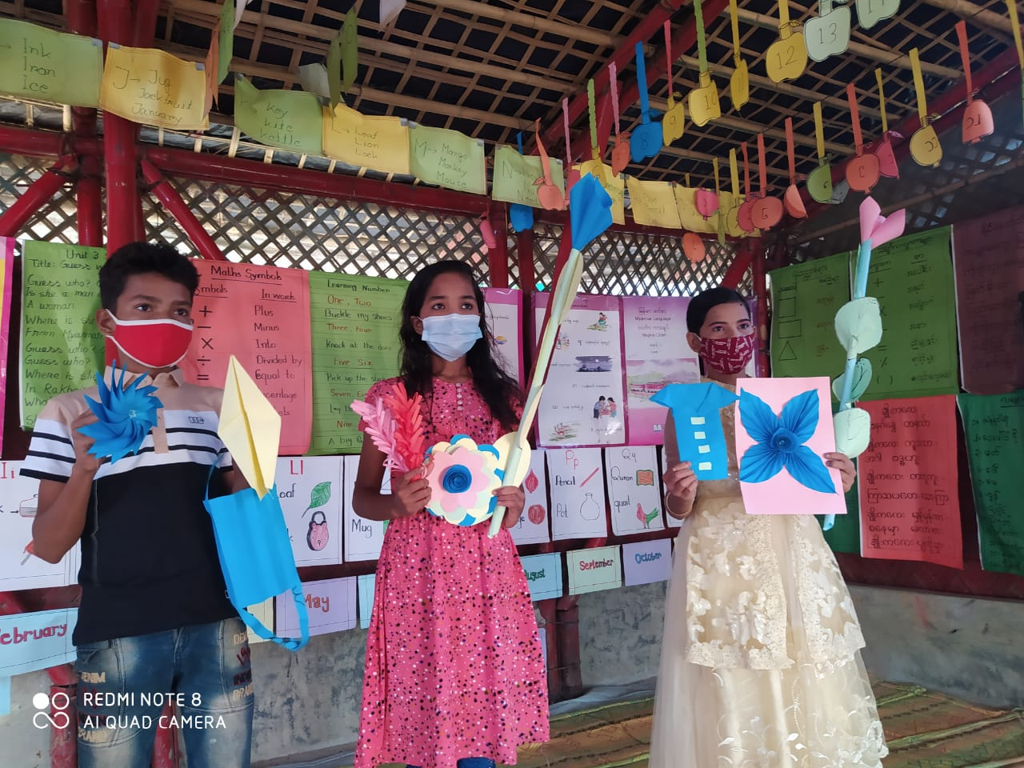
Child marriage situation in Cox’s Bazar during COVID-19 pandemic
A study by COAST Foundation
October 2021

Slide 2
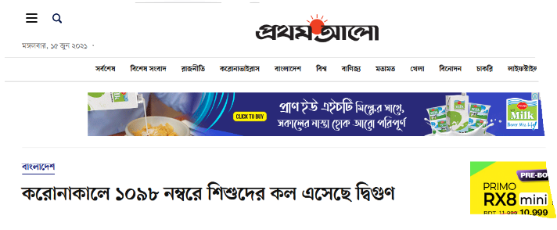
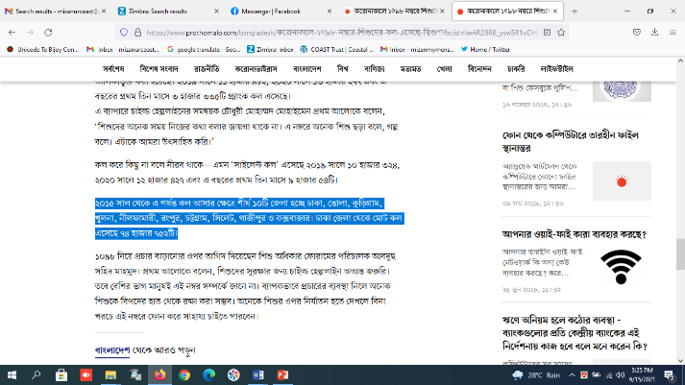
Background
Cox’s Bazar is one of the most affected districts from COVID-19;
Hosting around 9 Lac forcibly displaced Rohingya refugees;
All educational institutions were closed since March 2020 to August 2021;
Lower and middle-income families were in serious crisis due to lockdown;
Families found worried about education and future of their children, especially for the girl;

Slide 3
Objectives
1
To explore whether there is child marriage increases during this COVID pandemic in Cox’s Bazar District;
2
To understand the views of local people about child marriage;
3
To identify the measures to prevent child marriage;

Slide 4
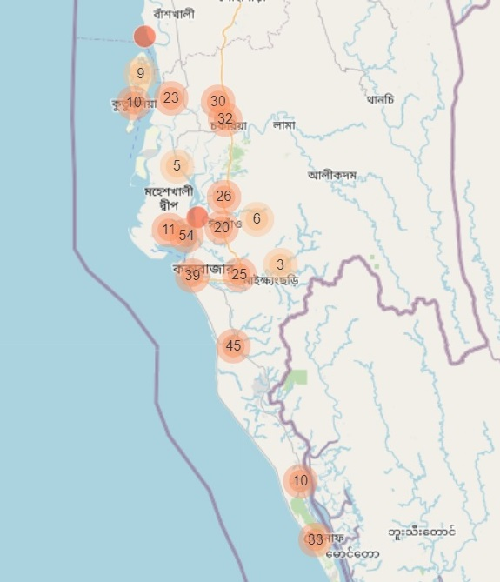
Survey areas
Survey conducted in 9 Upazila of Cox’s Bazar district
32 Unions and 3 Municipalities (Cox’s Bazar, Moheshkhali, and Chakaria Municipality) covered.

Slide 5
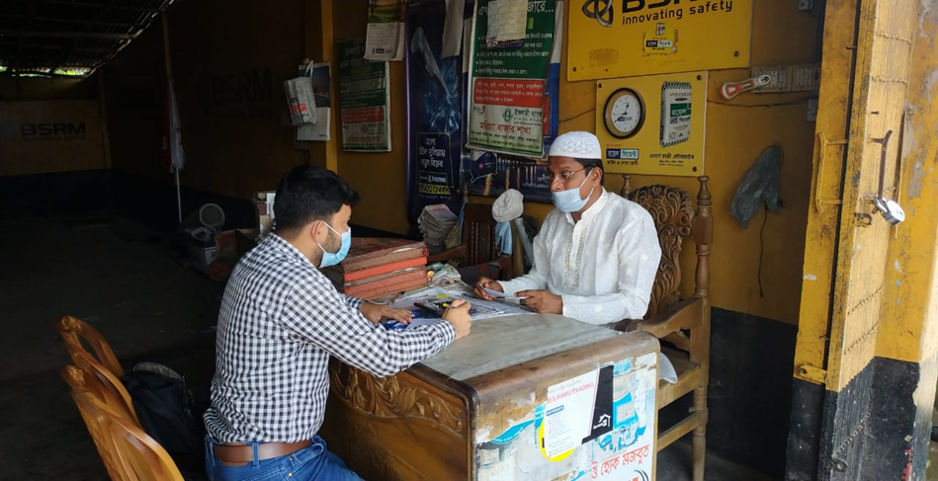
Methodology
Qualitative and quantitative survey
Random sampling;
Rural and urban context were taken into consideration for getting real data;
Teachers, UP member, Chairman, community people, adolescents, and government officials were interviewed;
384 sample take, 95% confidence level, and 5% margin of error assumed.

Slide 6
Respondents (Gender and age)

Slide 7
Educational status of respondents

Slide 8
Relationship between education & child marriage

Slide 9
% of child marriage (2020-21)

Slide 10
% of child marriage in terms of family economic status

Slide 11
Child marriage rates in terms of ages

Slide 12
Average educational attainment during their child marriage, happened

Slide 13
Causes behind child marriage increase
63% respondent thinks child marriage rate has increased during COVID-19 pandemic;
47% respondent reported child marriage increased due to closer of schools
26% reported that child marriage increased due to economic loss
22% said, parents committed child marriages due to loss of job and regular income.

Slide 14
People who took steps to prevent child marriage
55% respondents reported that people were relied on police and Upazila Chairman for child marriage prevention
39% respondents reported UP members and Chairman played important role to stop child marriage.
35% respondents think teachers also played significant role.
32% said, community people come forward to prevented child marriage.
22% respondents think NGOs play effective role in preventing child marriage.

Slide 15
Recommendation to prevent child marriage
65% respondents said stopping fake birth registration can reduce child marriage.
64% said opening of schools will reduce child marriage, which already happened.
38% said, effective implementation of law and order can reduce child marriage.
32% recommended for special social protection facilities to support the girls in vulnerable families to prevent child marriage.
28% said, awareness raising can help
And increase usages of hotline numbers to prevent child marriage.

Slide 16
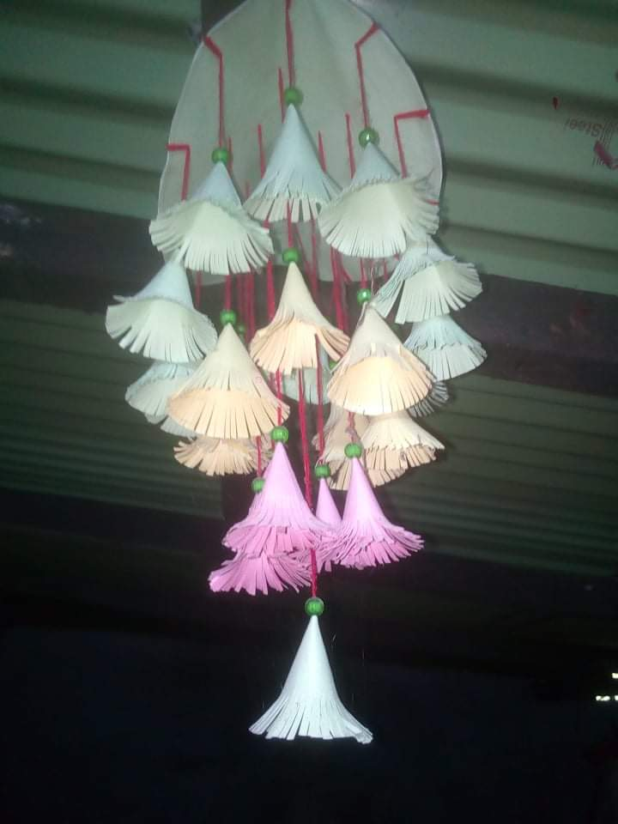
Thank you
Notes:
Camp: 15, Picture: Minar (M&E)

